Slide 1
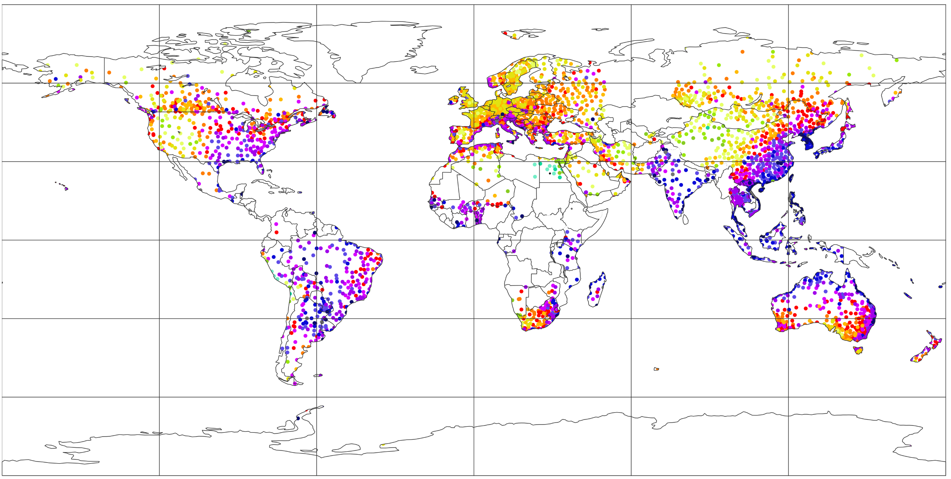
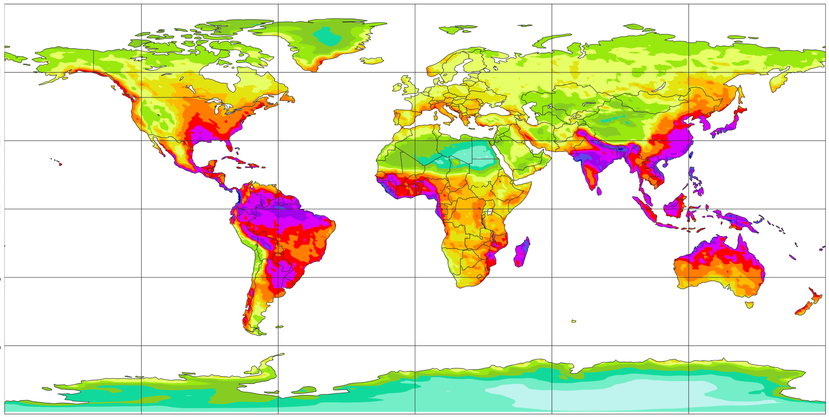
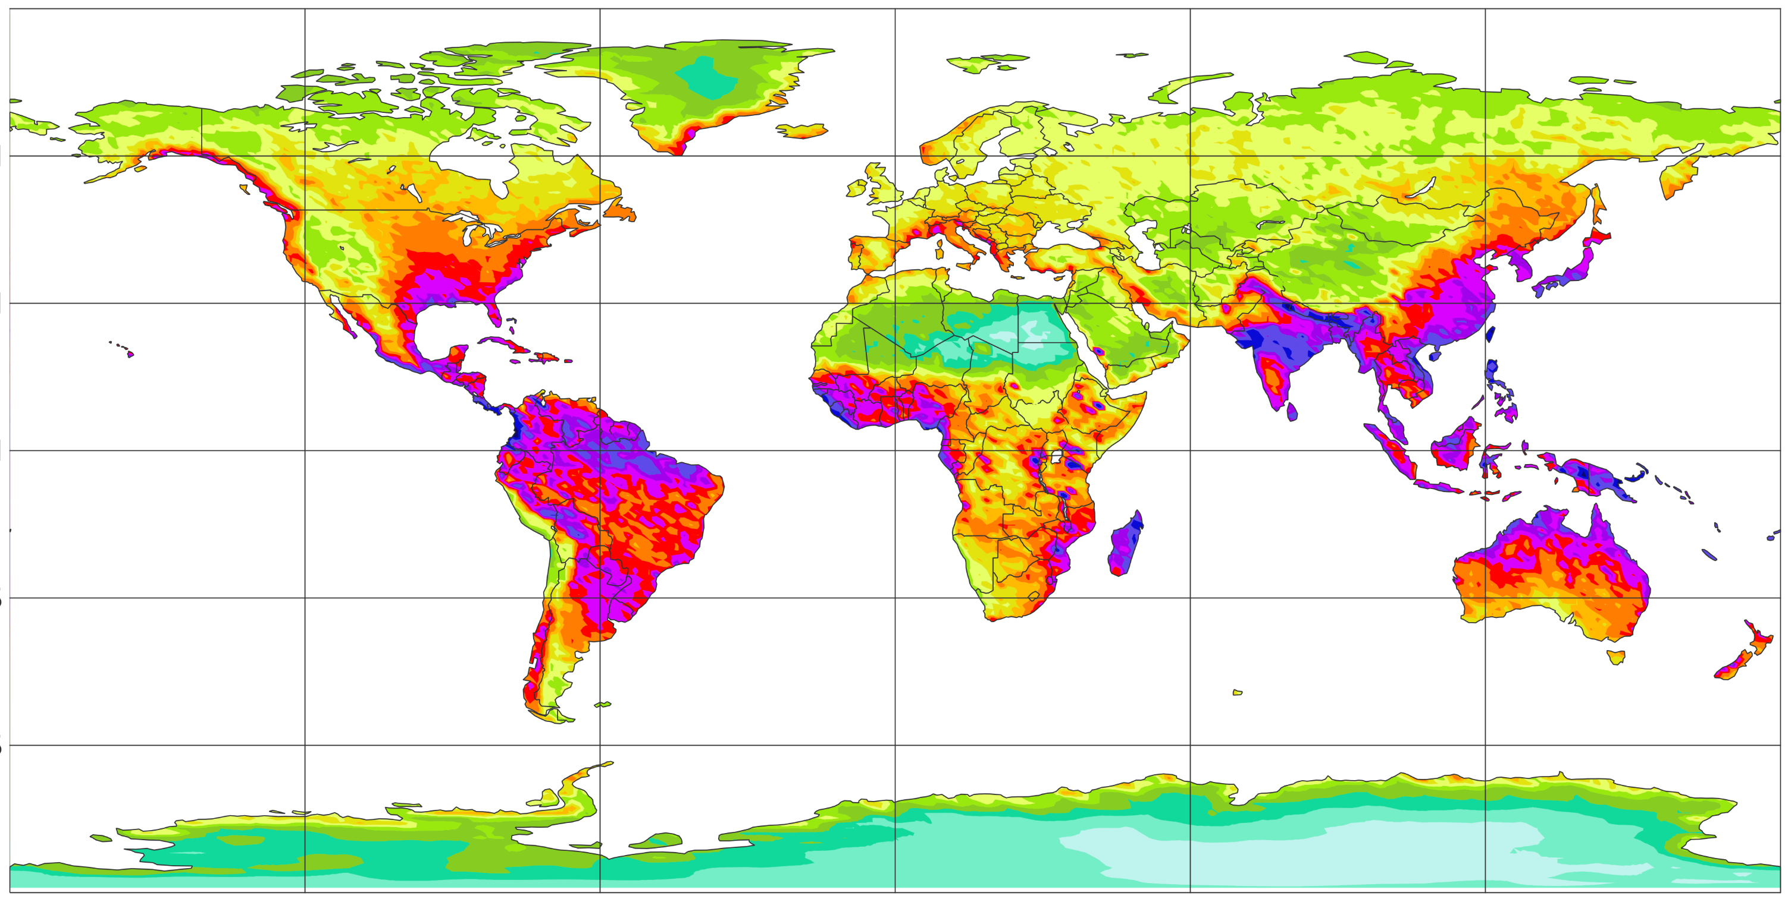
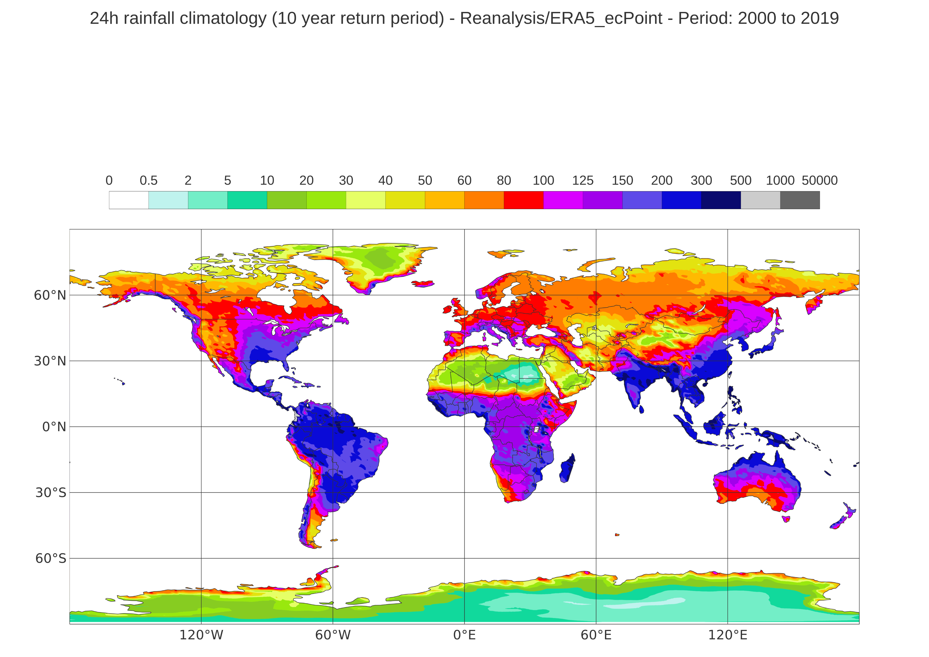
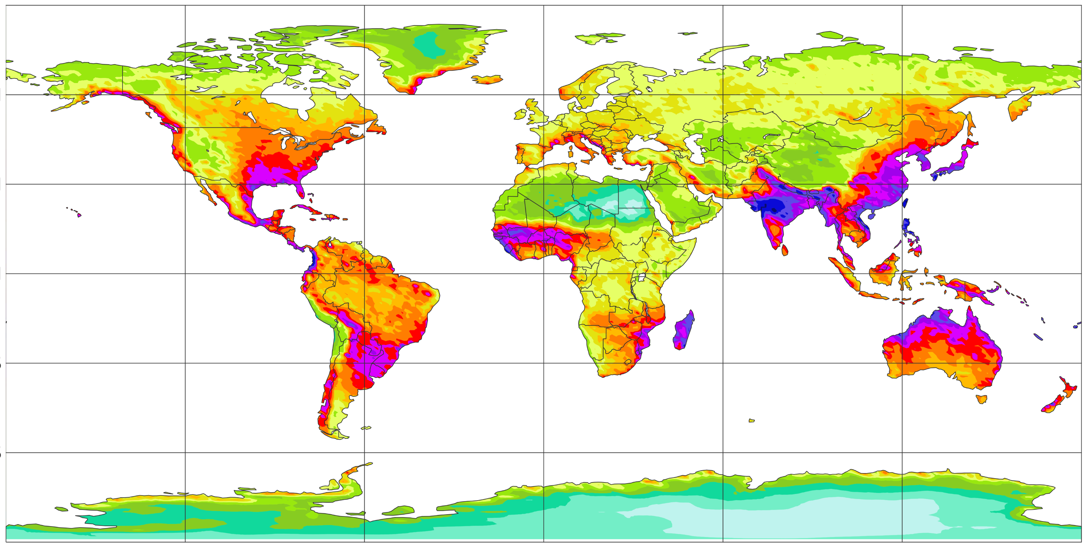

24-hourly rainfall climatology, 10-year return period
Valid from 2000 to 2019
(a) Rain gauge observations (point scale)
60 °N
mm/24h
inf
30 °N
1000
500
0 °N
300
30 °S
200
60 °S
150
125
120 °W
60 °W
0 °E
60 °E
120 °E
100
(b) ERA5 – EDA (62 km)
(c) ERA5 (31 km)
80
60 °N
60
30 °N
50
0 °N
30 °S
40
60 °S
30
(d) ECMWF Reforecasts - 46r1 (18 km)
20
(e) ERA5–ecPoint (point-scale in 31 km grid)
60 °N
10
30 °N
5
0 °N
2
30 °S
60 °S
0.5
120 °W
60 °W
0 °E
60 °E
120 °E
120 °W
60 °W
0 °E
60 °E
120 °E

